Slide 1
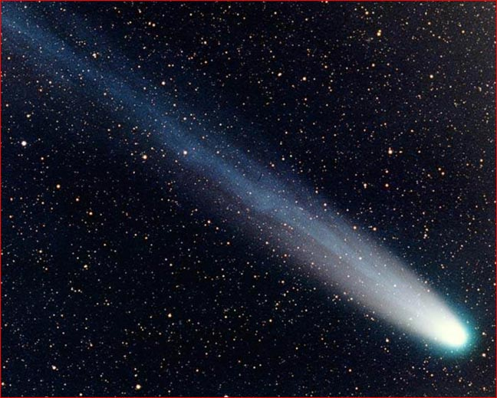
“The heavens are telling the glory of God; (Psalm 19.1a)
Church Growth
Holiday Forum 2014
Session 1

Slide 2
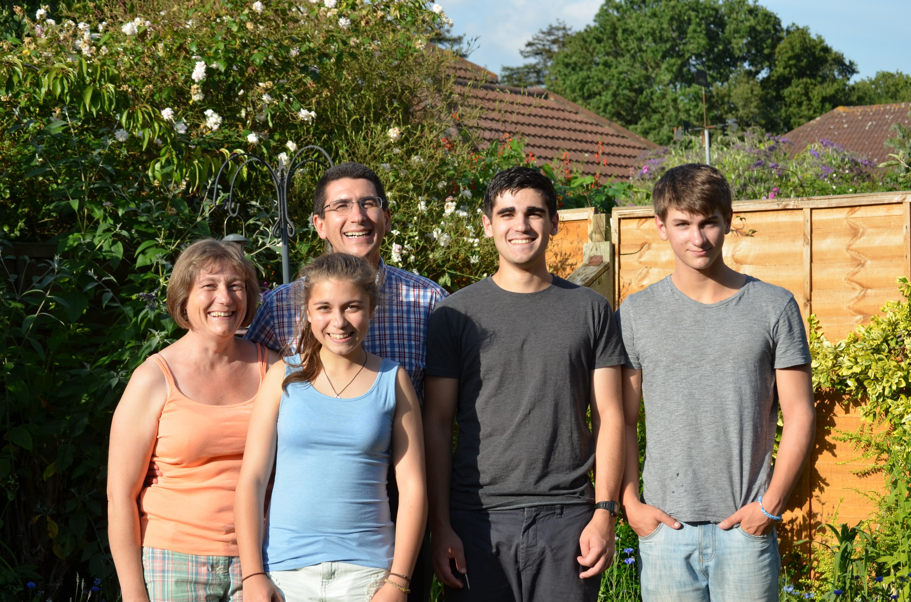
Introductions

Slide 3
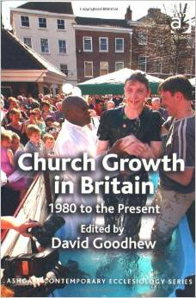
BOOK OF THE DAY
Church Growth in Britain
David Goodhew
SCM Press 2012

Slide 5
It is likely that as many churches have opened as have closed in Britain in the last three decades…
(Church Growth in Britain, David Goodhew, 2012)
A key finding of this volume is the way that church growth in contemporary Britain is most common in areas of migration, population growth and economic dynamism.

Slide 6
Our experience of church decline is in contrast to the facts. Why might this be the case?
What are significant factors in decline, in your experience?

Slide 7
Our experience of church decline is in contrast to the facts. Why might this be the case?
Large parts of the white British church are declining. Black, Asian and minority ethnic churchgoing is not declining; it is rapidly on the rise. Multi-cultural Britain has led to marked church growth in Britain.

Slide 8
The evidence… is that substantial church growth has taken place in Britain in recent decades. This poses a challenge to sociologists and historians – and indicates the urgent need to research such growth.
(Church Growth in Britain, David Goodhew, 2012)

Slide 9
Hope for the future…
If we can identify ways to help the church grow, then we could begin the process of reversing the decline in attendance
But we need more than the tools to turn around decline
We need to believe that the church can grow

Slide 10
Biblical models of Church Growth
1Corinthians 3: 4-13a

Slide 11
Verse 6: I planted…

Slide 12
Apollos watered the plant…

Slide 13
But it was God who made the plant grow..

Slide 14
Growing the church…
Requires ‘working together’
Requires ‘vision’
Requires ‘prioritising growth’
Requires ‘nurturing of disciples’

Slide 15
Paul’s example
Paul not only established new worshipping communities
He also kept in touch by letter
He visited to see how they were getting on
He wrote to offer advice and support

Slide 16
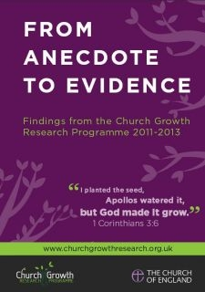
REPORT OF THE DAY
From Anecdote to Evidence
Church Growth Research Project
The Church of England

Slide 17
During the week we’ll keep returning to the key findings of this report which is available as a free download.

Slide 18
Can you think of a church which has experienced growth? What do you perceive as the reasons for that growth?

Slide 19
Some creatures have very different life-cycles. I wonder what the life cycle of a church looks like?

Slide 21
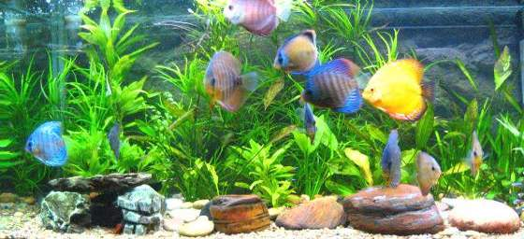
Are we keepers of the aquarium
or fishers of people?

Slide 22
Keepers of the aquarium?
Does your church focus more on the people already in the church than on those who are not yet in the church?

Slide 23
Think of your congregation, how many activities are aimed at people already in the church? How many activities are aimed at people beyond the church community? And how many ‘bridging activities’ help the two communities to interact?

Slide 24
A common ingredient strongly associated with growth in churches of any size, place or context:
Being intentional in prioritising growth
David Goodhew, From Anecdote to Evidence, 2014

Slide 25
“No spring nor summer beauty hath such grace
as I have seen in one autumnal face.”
Donne Elegy IX
The Autumnal

Slide 26
Every one of us has a role to play in growing the church – from the youngest to the oldest.

Slide 27
Church Growth
Holiday Forum 2014
Session 1

