Slide 1
Session 4
Taking risks

Slide 2
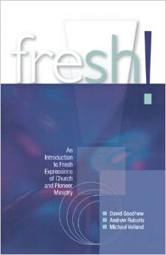
Book of the day
fresh!
by David Goodhew, Andrew Roberts, Michael Volland
scm press 2012

Slide 3
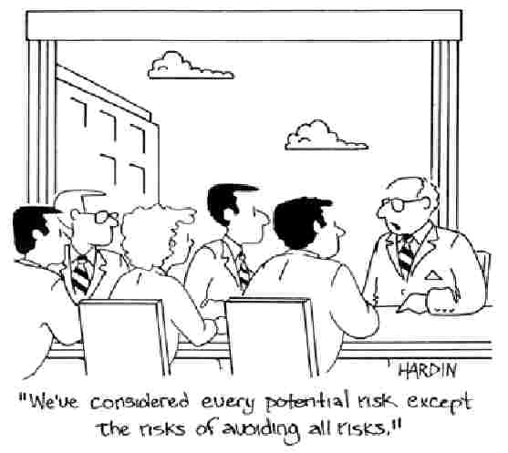

Slide 4
Perhaps the greatest risk facing the church is the unwillingness to take risks, to try something different, to change and adapt…
What happened to the last idea that you shared at church meeting or elders’ meeting?

Slide 5
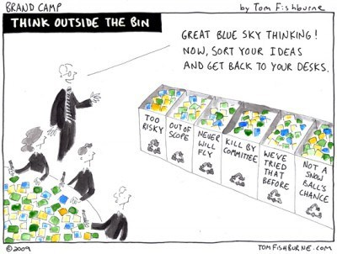

Slide 6
One of our problems is that we expect everyone to go at the same speed as us, whether we’re driving along the motorway or in a process of changing and developing our mission.
Think of the tortoise…

Slide 7
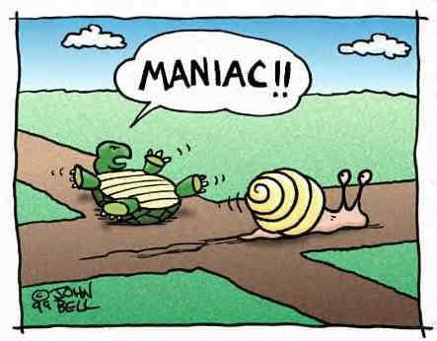

Slide 8
The truth uncovered by survey after survey is that churches that do not change decay, and churches that do change grow.
Bob Jackson, The Road to Growth, 2005

Slide 9
Eight changes associated with church growth (not in order of importance):
Planting new congregations
Worship less formal, more relaxed, better music
Improved provision for children and young people (family services, better groups…)
Improved welcome and integration – front door
Better small groups and pastoral care – back door
Regular use of evangelism courses
More lay involvement in leadership
Improved buildings and facilities

Slide 10
What would happen if the number of people going to church continued to decline in the United Kingdom?
Would anyone notice?
Would anyone care?

Slide 11
Is the church always one generation from extinction?

Slide 12
The importance of context

Slide 13
Paul addresses a different context
I see that in every way you Athenians are very religious. For as I walked through your city and looked at the places where you worship, I found an altar on which is written ‘To and Unknown God’.

Slide 14
Paul addresses a different context
Paul begins by making connection to the Athenian context
Paul uses their interest in spiritual issues to talk about Jesus Christ and the good news of salvation

Slide 15
Paul addresses a different context
Our challenge is to make connections with the people in our context
We can also use people’s interests to talk about Jesus Christ and the good news for all people, everywhere

Slide 16
A common ingredient strongly associated with growth in churches of any size, place or context:
Willingness to self reflect, to change and adapt according to context
David Goodhew, From Anecdote to Evidence, 2014

Slide 17
Tubestation Church,
Polzeath,
Cornwall

Slide 18
Reaching every generation – it’s a challenge – how might we begin to address the needs of every generation?

Slide 19
Think of your own church…
What risks have you taken in the last five or ten years?
How many things have you tried and then stopped?

Slide 20
If the church is to serve people as community in mission, it must connect with them. If it is to connect with them, it ust be contextual…
Michael Moynagh, p166

Slide 22
Where next?
Time to dream dreams…

Slide 24
Church Growth Session 4
Taking risks

